Slide 1
Haman Activity Recognition Project
Kuldeep Singh Shekhawat
July 09,2019
Notes:
July 09,2019

Slide 2
Abstract
In an experiment with a group of 30 volunteers within an age bracket of 19 to 48 years, each person performed six activities (WALKING, WALKING UPSTAIRS, WALKING DOWNSTAIRS, SITTING, STANDING, LAYING) wearing a smartphone (Samsung Galaxy S II) on the waist. The experiments have been video-recorded to label the data manually.
We review the performance of the models, and make suggestions that could improve future accuracy.
Exploratory data analysis and visualization techniques are used to gain a better understanding of the way users behave and how activities differ from one another.

Slide 3
Acknowledgement
I want to thank my mentor Dr. Sylvestor Sir and Yogendra singh sir for his contact support throughout this research and for encouraging me to do my best .I would also like to thank my committee Dr. Sylvestor sir ,yogendra singh sir , kunal sir ,krishna sir.

Slide 4
Intoduction
As more sensors are being built into mobile phones to measure our movements, positioning and orientation, the opportunity to understand this data and make improvements in our daily lives increases. The scope of our project consists of analyzing mobile phone sensor data in the context of activity recognition. More specifically, our objective is to build a model that accurately classifies whether an individual is walking, walking upstairs, walking downstairs, sitting, standing or laying using sensor data.
Mobile health applications that track a user’s activities over time can be beneficial for elderly assistance or personal health monitoring. In addition to providing personal support, this research also has connections to various fields of study including medicine, humancomputer interaction, and sociology.

Slide 5
Description of the dataset
The smartphone collected 3-axial linear acceleration and angular velocity measurements, each at a constant rate of 50 hertz, and the experiment was recorded for manual labeling of the response variables.
Feature variables for the dataset were then constructed by calculating metrics from the accelerometer signals in the time and frequency domain, including the mean, standard deviation, signal magnitude area, entropy, signal frequency, etc. In total, each observation corresponds to 561 constructed features from the data collected.
The dataset has been split into 70% training and 30% test data, with 21 of 30 participants in the train data and the remaining 9 participants in the test data.
In this dataset we take the two features from TEST.CSV and TRAIN.CSV features1 is the features of train.csv and featture2 is the part of test.csv
Labels are devided into two categories test1 from the train.csv and test2 from test.csv
We find the result by 4 method (a) a (simple) tree approach, (b) a random forest approach and (c) a logistic regression. (d) KNN approach and check that which metho d is the best

Slide 6
Library and Regression
RegressionA regression problem is when the output variable is a real or continuous value, such as “salary” or “weight”. Many different models can be used, the simplest is the linear regression. It tries to fit data with the best hyper-plane which goes through the points.
Libraries
1. Matplotlib= is a Python 2D plotting library which produces publication quality figures in a variety of hardcopy formats and interactive environments across platforms. Matplotlib can be used in Python scripts, the Python and IPython shells, the Jupyter notebook, web application servers, and four graphical user interface toolkits.
2. scikit-learn= Scikit-learn is probably the most useful library for machine learning in Python. It is on NumPy, SciPy and matplotlib, this library contains a lot of effiecient tools for machine learning and statistical modeling including classification, regression, clustering and dimensionality reduction.

Slide 7
conclusin
In this project I discussed Activity Recognition, drew visualisations from the dataset and used machine learning algorithms for classifying activities. As per the results, Logistic Regression achieved the highest accuracy.

Slide 8
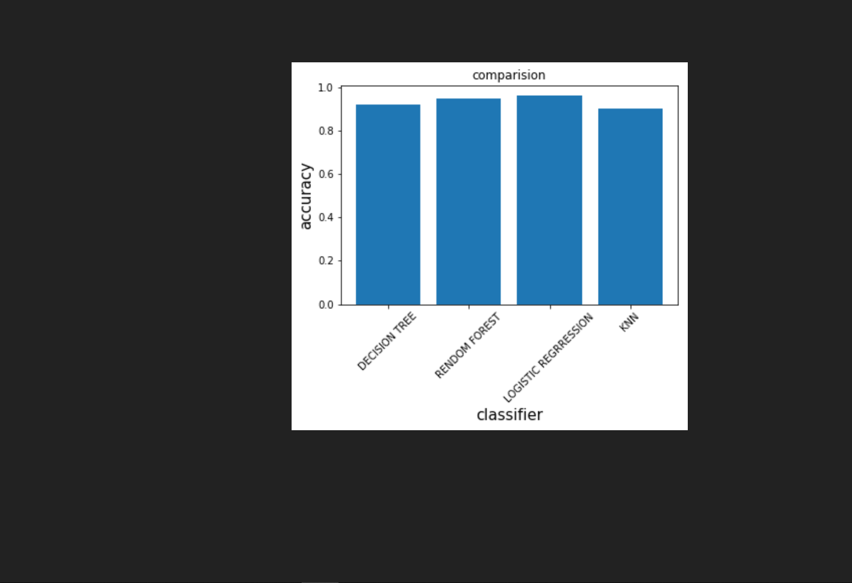
Logistic regression gives us best accuracy . so it is best

Slide 9
Result
Result is shown in tables in fig.
Result shown in table
And cm(confusion matrix )

Slide 10
Reference
[1] UCI Machine Learning Repository, "Smartphone-Based Recognition of Human Activities and.Postural Transitions Data Set," 29 07 2015. [Online]. Available:http://archive.ics.uci.edu/ml/datasets/SmartphoneBased+Recognition+of+Human+Activities+and+Postural+Transitions. [Accessed 23 102017].

